Slide 1
Mule Soft 4.0 Introduction

Slide 2
UNIT I:
Application Networks and API-Led Connectivity:
Define Application Networks and Benefits,
Build an Application Network Using API-Led Connectivity,
Examine Web Services and APIs ,
Secure and Unsecured APIs Using Calls
Introduction to Anypoint Platform:
Discover Anypoint Platform Benefits,
Explore Application Network Component Functions,
Navigate Anypoint Platform,
Locate APIs and Other Assets

Slide 3
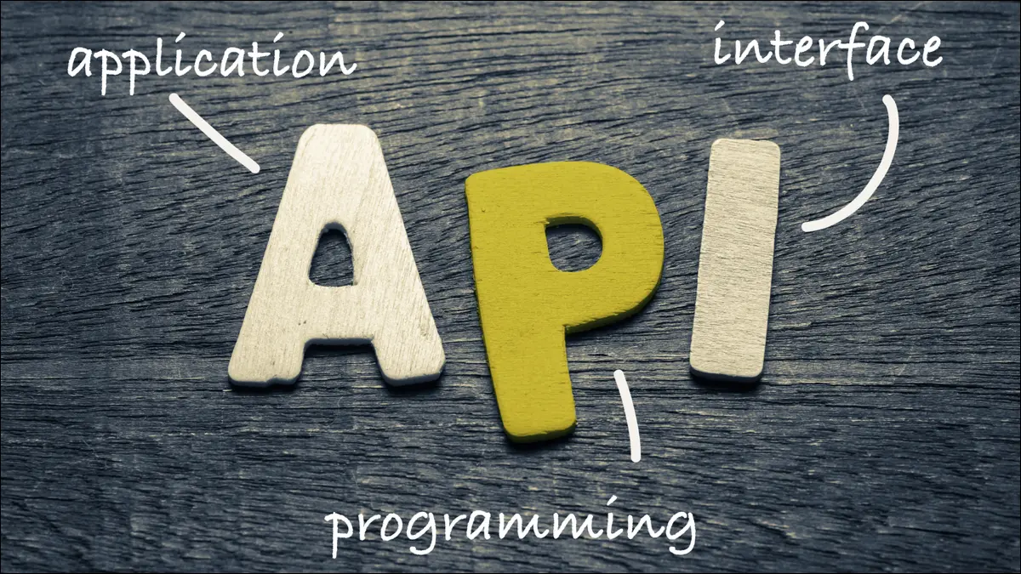
What is an API ?

Slide 4
What is an API ?
The term API is an acronym, and it stands for “Application Programming Interface.”
API are the set of commands for how a service can be used.
API allows two applications to talk to each other.
In Simple word we say that API acts as a middle man, which takes input and provide output.

Slide 5


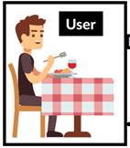

What is an API?
APP
Request
Request
Response
Response
Server
Client
API

Slide 6
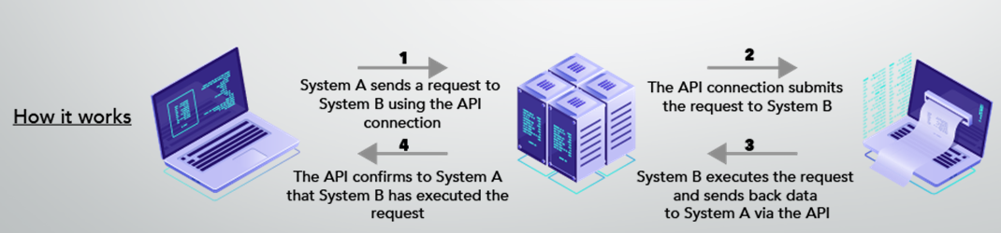

Slide 7
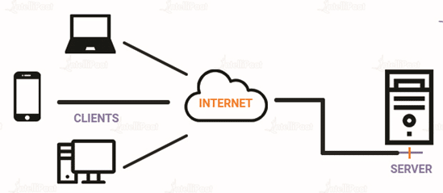
What is need of API ?
WWW and remote servers
When I think about the Web, I imagine a large network of connected servers.
Every page on the internet is stored somewhere on a remote server. A remote server is not so mystical after all — it’s just a part of a remotely located computer that is optimized to process requests.

Slide 8
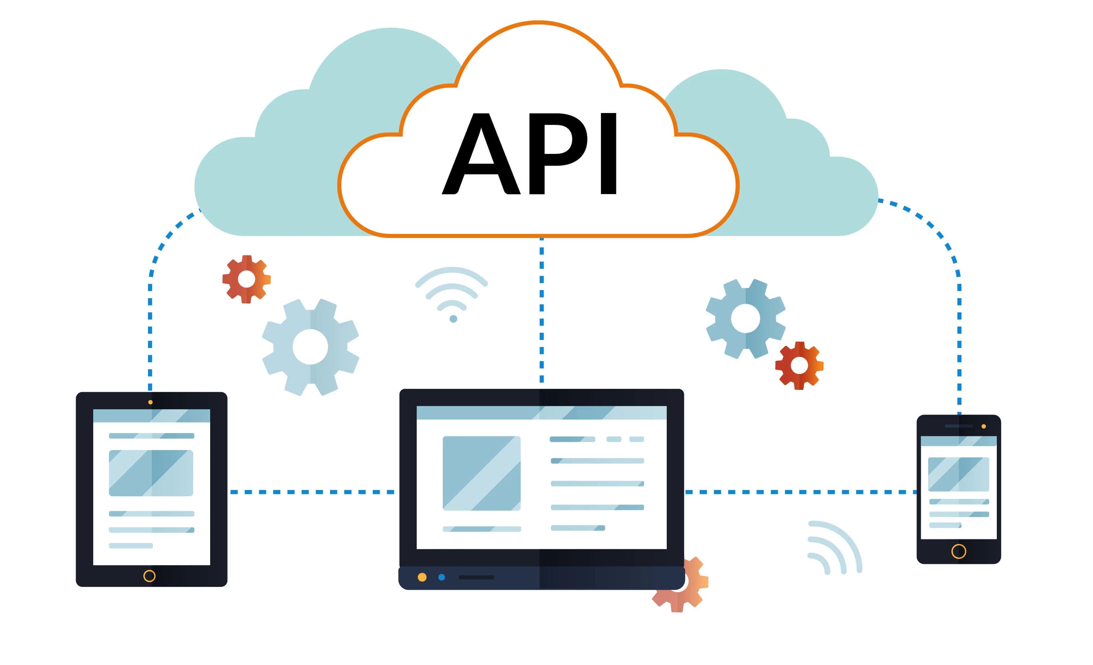
When you type www.facebook.com into your browser, a request goes out to Facebook’s remote server. Once your browser receives the response, it interprets the code and displays the page.
To the browser, also known as the client,Facebook’s server is an API.
This means that every time you visit a page on the Web, you interact with some remote server’s API.
An API isn’t the same as the remote server — rather it is the part of the server that receives requests and sends responses.

Slide 9
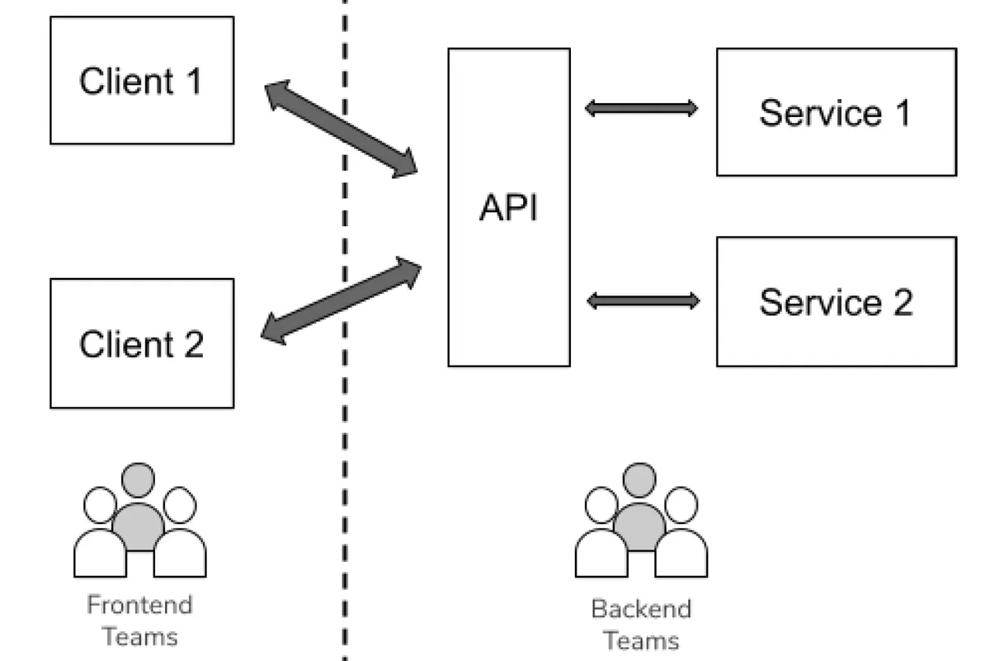

Slide 10

What is need of API ?
APIs Make Life Easier for Developers
Let’s say you want to develop an app for an iPhone. Apple’s iOS operating system provides a large number of APIs—as every other operating system does—to make this easier on you.
If you want to capture photos or video from the iPhone’s camera, you don’t have to write your own camera interface.
You use the camera API to embed the iPhone’s built-in camera in your app.
If APIs didn’t exist to make this easy, app developers would have to create their own camera software and interpret the camera hardware’s inputs.

Slide 11
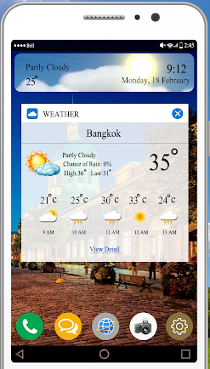
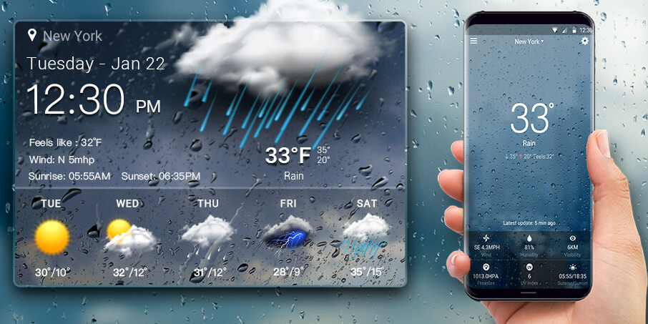
What is Integration?
Weather forecasting on Mobile

Slide 12
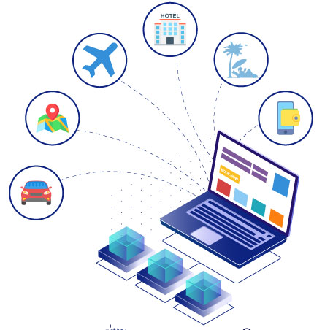
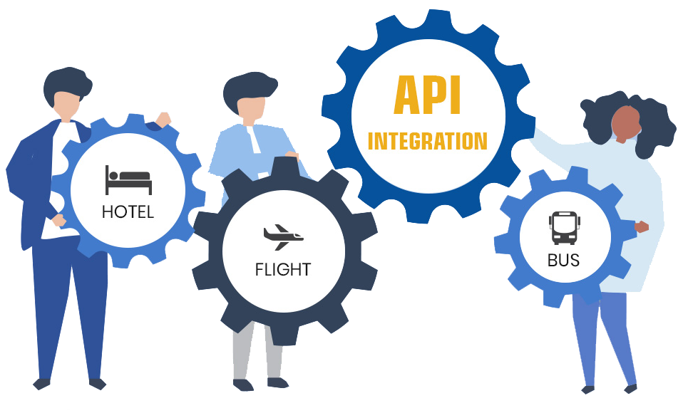
Travel Agency System
The process of making communication between different systems is call it as Integration.

Slide 13
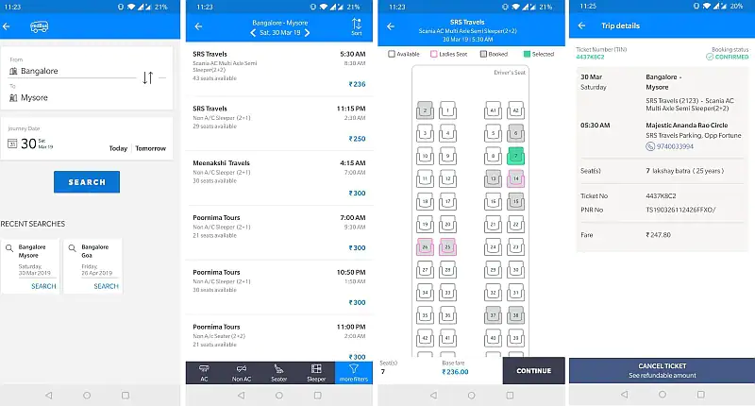

Slide 14
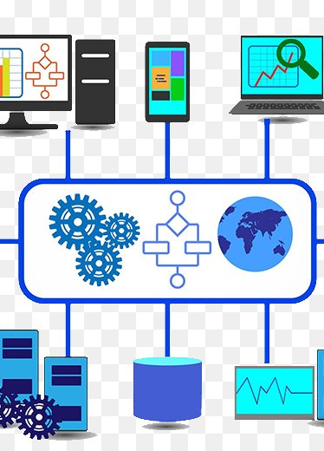
What is Integration?
Software integration is the process of bringing together various types of software sub-systems so that they create a unified single system.
The process of making communication between different systems is call it as Integration.

Slide 15
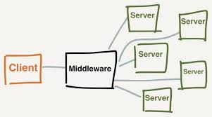
MIDDLE WARE
Middleware is a more effective program that acts as bridge in between various applications and other databases otherwise tools.
It is placed in between operating system and other applications which run on it. Middleware allows making better communication, application services, messaging, authentication, API management and management of data between different kinds of applications which help to exchange data.
Middleware is also known as plumbing because it’s both sides are connected with different applications, and it helps to transfer data in both side.

Slide 16



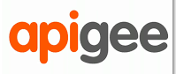

DIFFERENT INTEGRATION PLATFORMS
Mule Soft
Dell Boomi.
Jitterbit.
SnapLogic Intelligent Integration Platform (IIP)
Apigee
Tibco BusinessWorks.
Cleo Integration Cloud.
Software AG webMethods.
Celigo.

Slide 17
Enterprise Service Bus (ESB)
ESB is a middleware architecture based on SOA.
It is based on service providers, service consumers and event flows. Service providers generate events and publish to the event bus which is known as Enterprise Service Bus. Service consumers consume events they are interested in. ESB supports both synchronous and asynchronous events flows.
ESB is a middleware architecture based on SOA
SOA, or service-oriented architecture, defines a way to make software components reusable and interoperable via service interfaces.

Slide 18
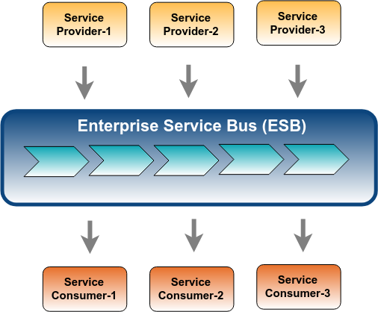

Slide 19
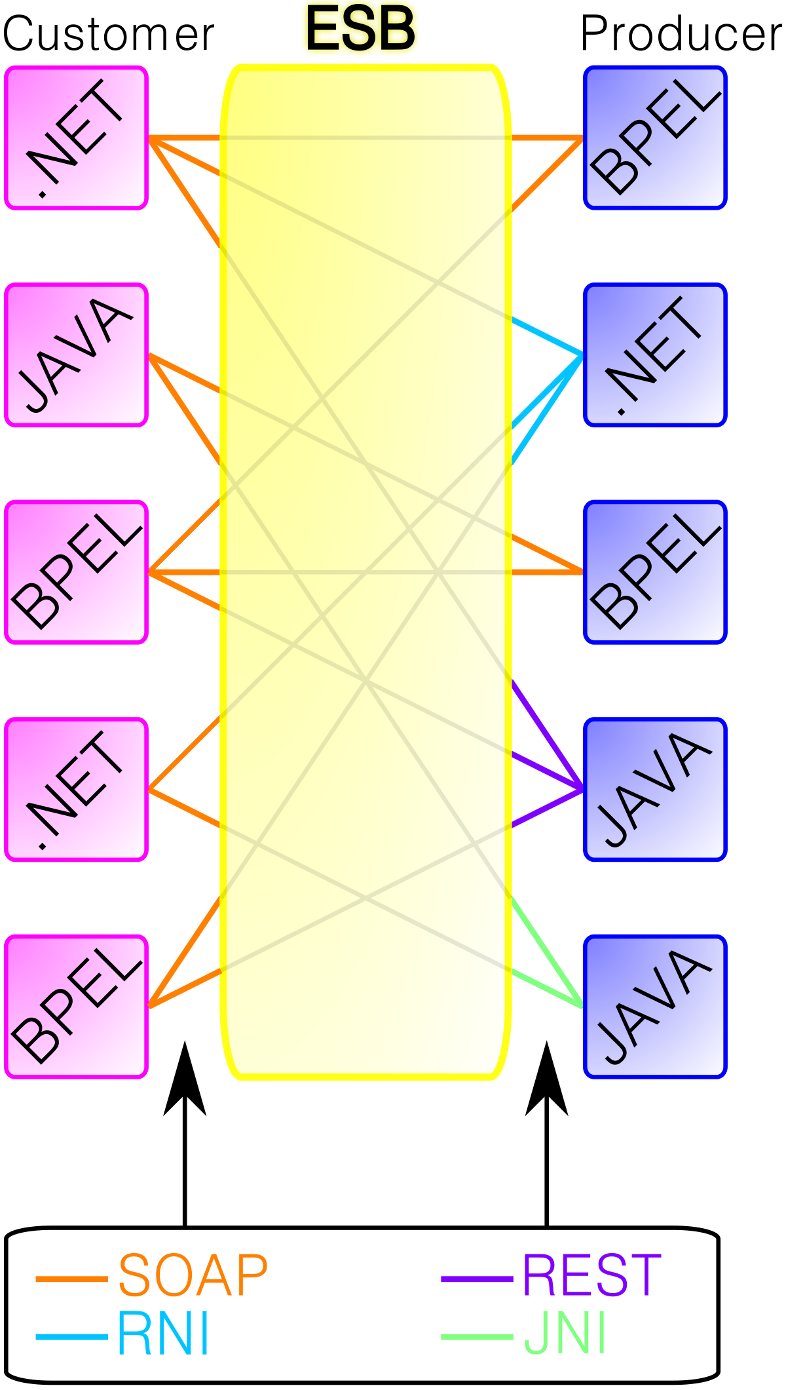
API Management — to expose internal resources to external world with proper security and QoS
Messaging Queues — to build asynchronous communication with external systems.
Business Processes — to engage humans or equipment within message flows in certain validations.
Identity and Access Management — to manage access within the solution.
Monitoring and Alerting — to identify run-time issues and act fast.

Slide 20
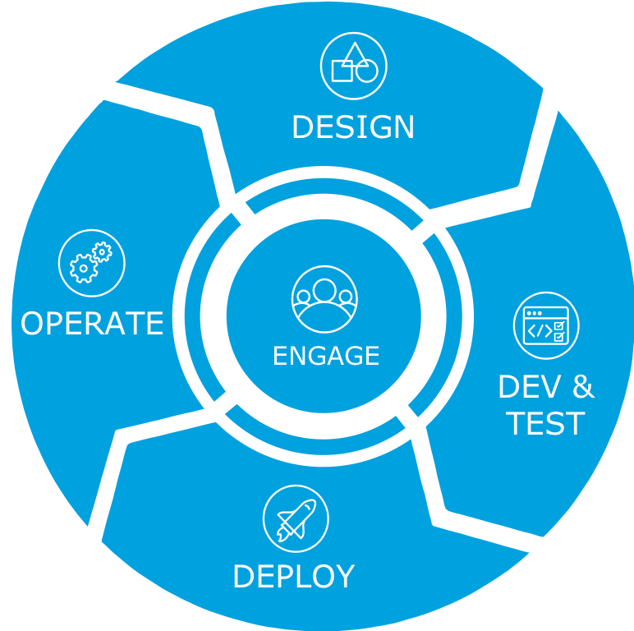
API Life Cycle

Slide 21
Key Elements of an API Interface:
Endpoints (URLs):The paths you can call, like /users or /orders.
HTTP Methods:The type of operation (GET, POST, PUT, DELETE).
Parameters:Data sent with requests (query parameters, path variables, headers).
Request Body:The structure of data sent (often in JSON or XML).
Response:What the server sends back — data format, status codes, etc.
Authentication/Authorization:How users prove their identity (e.g., API keys, OAuth tokens).

Slide 22
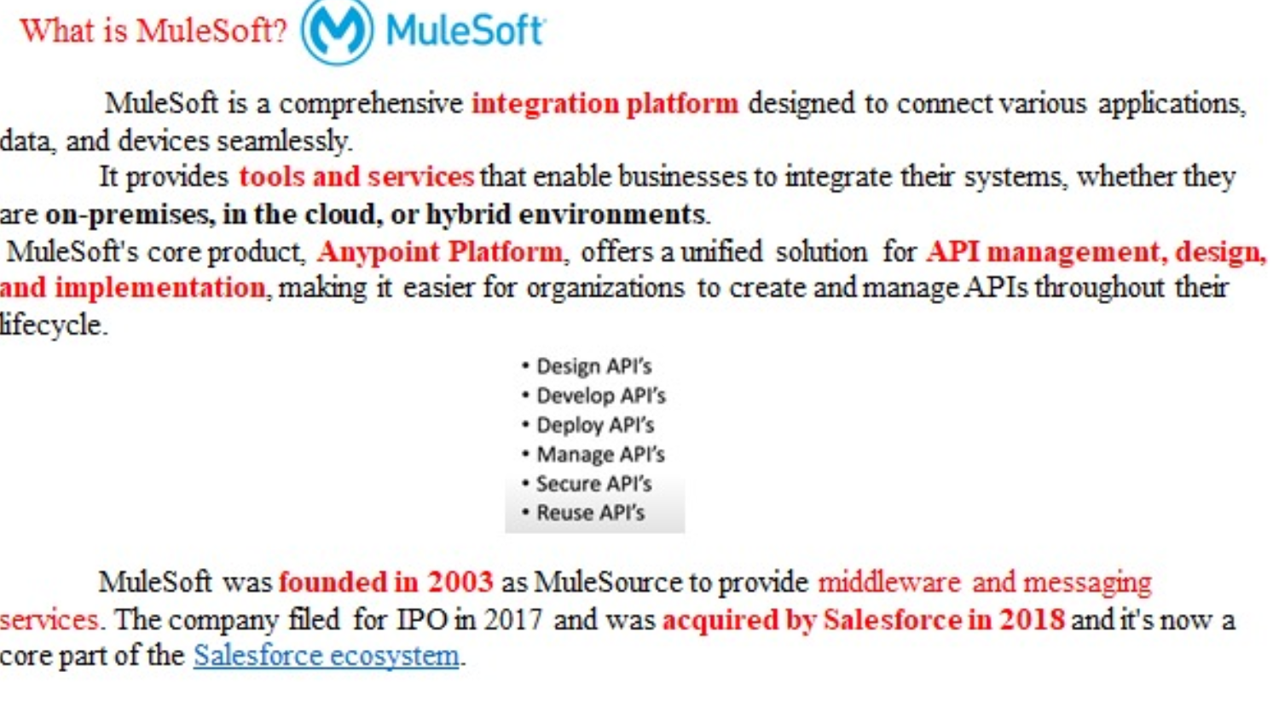

Slide 23
Application Networks and Benefits
Application Network is an approach to connecting applications, data and devices. This is done in the application network by defining simple abstractions.
The API is the best abstraction we have in the enterprise for exchanging information between two parties. And that is exactly what is being done — information is being exchanged between other applications.
An application network is pretty simple; it is a way to connect applications, data and devices through APIs that exposes some or all of their assets and data on the network.
That network allows other consumers from other parts of the business to come in and discover and use those assets.
Building an application network involves developing reusable assets and then encouraging those in the business to reuse and self-serve those assets. Then, they can get used and reused in different ways inside the organization.
Connections can then be built between these assets. It is necessary to allow development teams in the business to build what is needed — to self-serve the reusable assets created by others to in order to develop something new — and then expose it to the rest of the organization to be reused.
For example, the customer service representatives are exchanging information with the BI department doing analytics reporting. Another group inside the business is exchanging information with partners involved in B2B transactions. APIs are the perfect model for those exchanges because they provide a definition of both the provider and the consumers as well as provide a way for the interactions to be managed very closely.

Slide 24
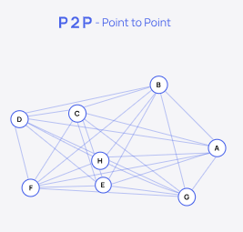
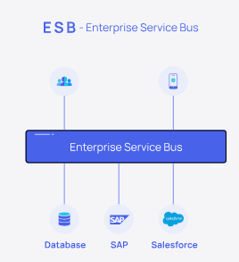
API-Led Connectivity
When integration was introduced decades back, P2P or Point-to-Point integration was the only option where integration was so complicated.
Later, Enterprise Service Bus – ESBs were introduced in which there was a common layer or a bus through which integrations were made. However, these traditional integration solutions no longer help in scaling and innovating rapidly for businesses of today.
And there comes the API-Led connectivity approach, through which integrations were made simpler, easier, faster, and more importantly, economical.

Slide 25
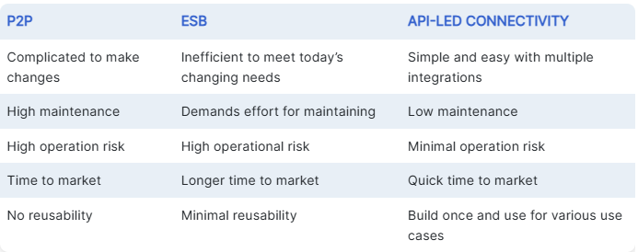
API-Led Connectivity

Slide 26
API-Led Connectivity
API-led connectivity is a method of integrating systems and applications using reusable, purpose-built APIs, creating what's known as an application network
API-led connectivity is an architectural approach that uses reusable APIs to connect data and applications.
API-led connectivity follows a “bottom-up” approach, starting with the creation of APIs at the system layer. These APIs are then reused and combined to build higher-level APIs.
This approach encourages reusability, modularity, and separation of concerns, making it easier to manage and update integrations as the organization’s needs evolve.

Slide 27
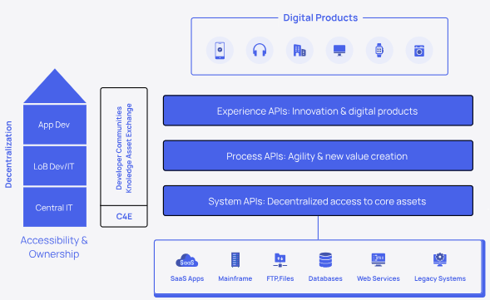
Layers in API led connectivity
Three Layers :
System Layer
Process Layer
Experience Layer

Slide 28
System APIs
System API’s are built to connect through underlying systems (Any system which contains the raw data).
Basically System API contains Sensitive information as it contains raw data.
Should never be exposed for public use.
Eg : APIs which connect to Databases , Salesforce, SAP systems, Hadoop systems etc.

Slide 29
Process APIs
Process API’s are built to compose or combine two or more System API’s Usually to do any kind of transformation or to implement any kind of business logics or shape the data out of system apis.
It may perform aggregation / splitting / routing the data.
Process APIs must be private and should not be exposed to public for use.
Eg: Aggregating Customer Data and Product Data that comes from 2 system APIs where Actual data is originated , to provide Order Status.

Slide 30
Experience APIs
These are API’s which are a kind of a wrapper either to Process API’s (if present ) or to System API’s , so that Client/Consumers can use it. Client/Consumers will not have exposure or contact with direct Raw Data.
We can have minimal Data Transformation like the final result to be in JSON or XML or whatever the consumer wants to have.
Remember , if there is any change in System API , we do not need to modify or change anything.

Slide 31
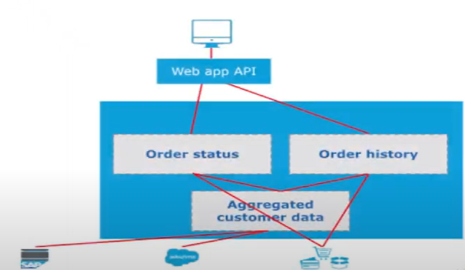
Build an Application Network Using API-Led Connectivity

Slide 32
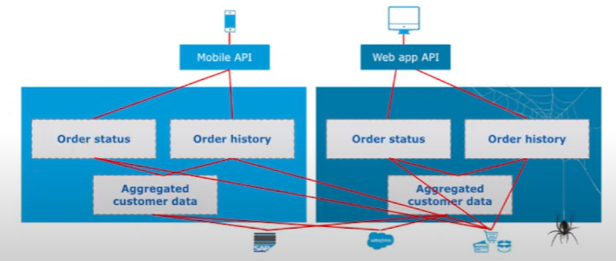
Build an Application Network Using API-Led Connectivity

Slide 33
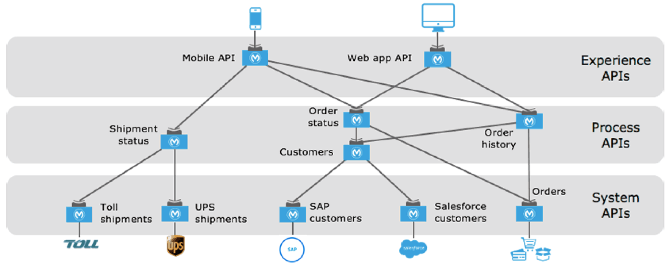
Build an Application Network Using API-Led Connectivity

Slide 34
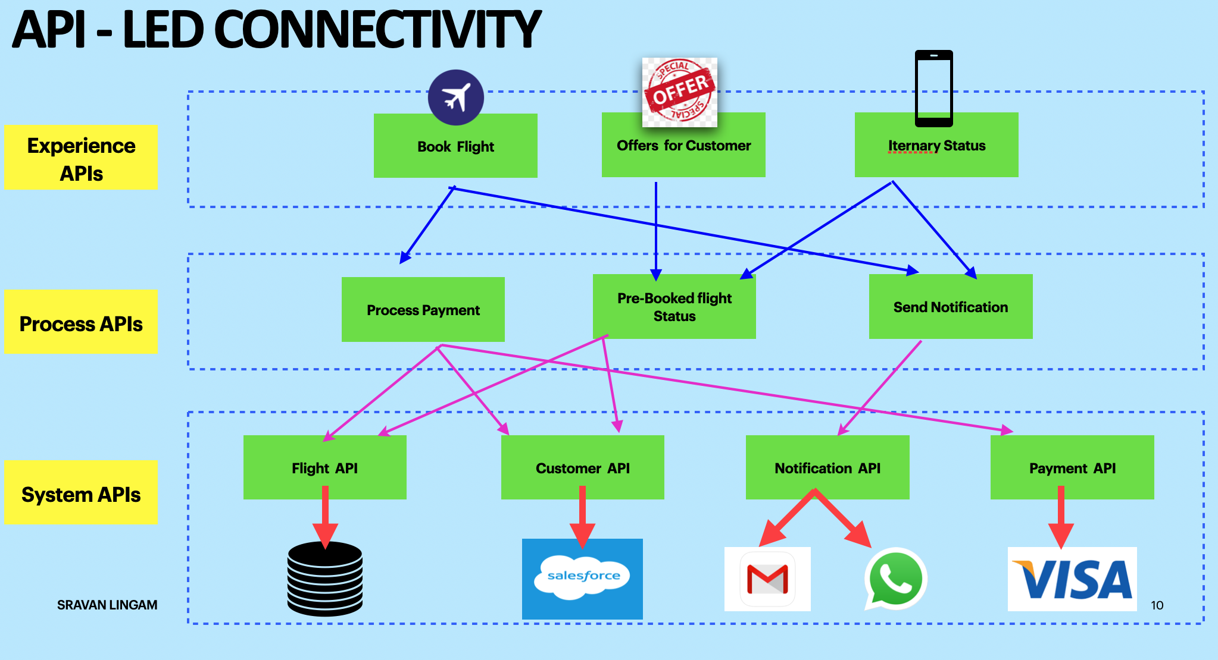

Slide 35
Web Services and APIs
web services include any software, application, or cloud technology that provides standardized web protocols (HTTP or HTTPS) to interoperate, communicate, and exchange data messaging – usually XML (Extensible Markup Language) – throughout the internet.
web services are XML-centered data exchange systems that use the internet for A2A (application-to-application) communication and interfacing. These processes involve programs, messages, documents, and/or objects.
A key feature of web services is that applications can be written in various languages and are still able to communicate by exchanging data with one another via a web service between clients and servers.
A client summons a web service by sending a request via XML, and the service then responses with an XML response.

Slide 36
Different Types of Web Services
There are a few central types of web services: XML-RPC, UDDI, SOAP, and REST:
XML-RPC (Remote Procedure Call) is the most basic XML protocol to exchange data between a wide variety of devices on a network. It uses HTTP to quickly and easily transfer data and communication other information from client to server.
UDDI (Universal Description, Discovery, and Integration) is an XML-based standard for detailing, publishing, and discovering web services. It’s basically an internet registry for businesses around the world. The goal is to streamline digital transactions and e-commerce among company systems.
SOAP, (Simple Object Access Protocol) is an XML-based Web service protocol to exchange data and documents over HTTP or SMTP (Simple Mail Transfer Protocol). It allows independent processes operating on disparate systems to communicate using XML.
REST,(Representational State Transfer) provides communication and connectivity between devices and the internet for API-based tasks. Most RESTful services use HTTP as the supporting protocol.

Slide 37
How web services work
Web services let different organizations or applications from multiple sources communicate without the need to share sensitive data or IT infrastructure.
All information moves through a programmatic interface across a network. This interface can then be added to a GUI, like a webpage, to deliver specific functionality to users.
This means web services aren't specific to one programming language or operating system (OS) and don't require the use of browsers or Hypertext Markup Language (HTML).

Slide 39
Secure and Unsecured APIs Using Calls
Secure and unsecured API calls differ primarily in their approach to protecting data and access.
Secure API calls utilize encryption, authentication, and authorization to prevent unauthorized access and data breaches,
while unsecured calls lack these protective measures, leaving them vulnerable to attacks.
securing API calls involves implementing robust security measures to protect data, control access, and mitigate potential threats.
Unsecured API calls lack these measures, making them vulnerable to various attacks.

Slide 40
Secure API Calls:
Authentication and Authorization:
Secure APIs verify the identity of the user or application making the request and ensure they have the necessary permissions to access the requested resource.
Encryption:
Data transmitted between the client and the API is encrypted (e.g., using HTTPS with TLS) to protect it from eavesdropping and tampering.
Input Validation:
APIs validate all incoming data to prevent injection attacks (e.g., SQL injection, XSS) and ensure the data is in the expected format.
Rate Limiting and Throttling:
APIs implement limits on the number of requests a user or application can make within a certain timeframe to prevent abuse and denial-of-service attacks.
Auditing and Logging:
API usage is logged to track activities and identify potential security incidents.
API Gateways:
API gateways act as a central point of entry for API traffic, providing security features like authentication, authorization, and traffic management.
Token-based Authentication:
APIs use tokens (e.g., JWT) to authenticate users and applications, providing a secure and efficient way to manage access.

Slide 41
Unsecured API Calls:
Lack of Authentication and Authorization:
Unsecured APIs may not require any form of authentication, allowing anyone to access resources.
Unencrypted Data:
Data transmitted between the client and API is not encrypted, making it vulnerable to interception and modification.
Lack of Input Validation:
APIs that don't validate input are susceptible to various injection attacks.
No Rate Limiting:
Without rate limiting, APIs can be easily overwhelmed by malicious traffic, leading to service disruptions.
Limited or no Auditing:
Unsecured APIs may not track API usage, making it difficult to identify and respond to security incidents.
Direct Endpoint Exposure:
Unsecured APIs might expose endpoints directly to the public internet, increasing the attack surface.

Slide 42
Introduction to Anypoint Platform
The MuleSoft's Anypoint Platform is a unified, single solution for iPaaS and a full life-cycle API management. The Anypoint Platform consists of the following major components:
Anypoint Security,
Anypoint Design center,
Anypoint Management center,
Anypoint Exchange,
Runtime engine & services,
API-led connectivity,
Application Network,
DataWeave.

Slide 43
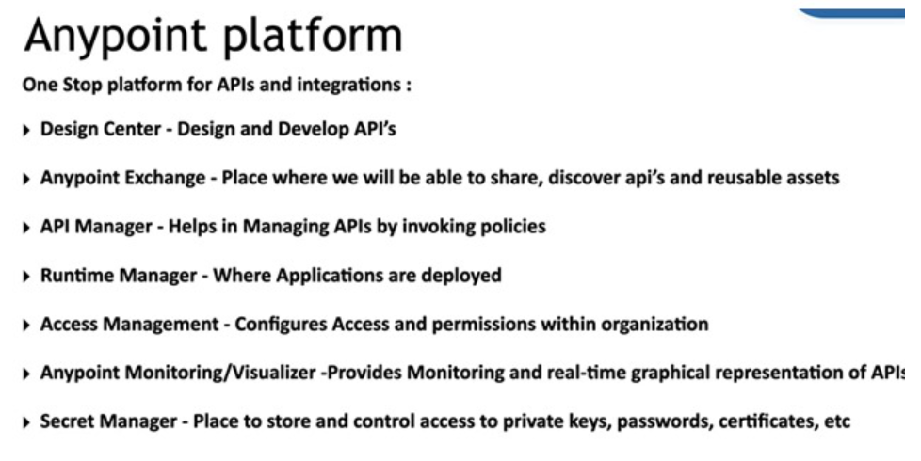

Slide 44
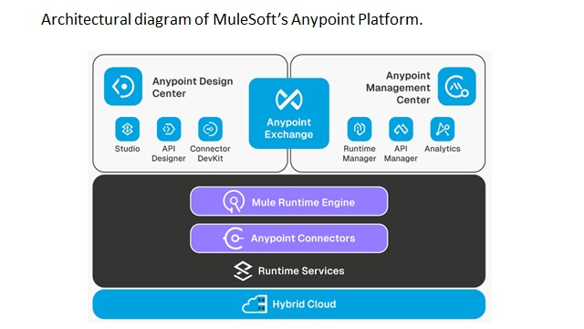

Slide 45
Anypoint Platform Components
Design Center
Design Center provides tools to design the APIs, developer Connectors and MuleSoft Applications. RAML is used to design the APIs.
Anypoint Exchange
Anypoint Exchange is repository hub where you can store your reusable assets and search for connectors, public or private assets.
Repository hub for public templates, connectors, documents etc.
Store the assets like templates, common frameworks, documentation to be access by your organizations.
Runtime Manager
Runtime Manager is the place where you can deploy and manage the MuleSoft Application. It also provide capabilities to setup Anypoint Virtual Private Cloud, Virtual Private Network and Dedicated Load Balancer.
Manage application deployment lifecycle.
Enable the alerts like CPU Usage, Memory Usage, Worker Not Responding etc.
Create and Manage Anypoint VPC, VPN and DLB.
View the application metrics like CPU Usage, Memory Usage etc.
Enable Static IP Address for the applications.

Slide 46
API Manager
API Manager is the component of the Anypoint Platform for managing the lifecycle of API and secure the APIs using policies. This component basically governed the APIs.
Securing the APIs by applying policies like IP Whitelisting, Blacklisting, JWT Validation Policy, Client Id Enforcement Policy etc.
Discover and manage the API lifecycle.
Enable the Alerts for policies violations, response time etc.
View API Analytics.
Manager API Contracts and SLA's.
Apply API Policies like logging policy, header add and removal policies or any security policies.
Proxy existing SOAP services or create new APIs from OAS and RAML definitions.
Unlock applications, data, and microservices with an API gateway.
Access Management
This component is basically used to manager users, subscriptions, roles, organization, environments, Identity Management etc.
User Management.
Roles creation and mapping to users.
User Identity Management using SAML 2.0 and OpenID Connect.
Client Management using OpenID Connect Dynamic Client Registration.
Business Group Management.
Subscriptions Management.
Enabling Multi-factor authentication.
Anypoint DataGraph
Anypoint DataGraph is component of Anypoint Platform which allows you to unify the multiple APIs into single data service.
With Anypoint DataGraph, you can reuse multiple APIs in a single request. Enterprise architects can easily unify APIs into one data service — all without writing more code. Developers can consume multiple APIs from the data service in a single GraphQL request.

Slide 47
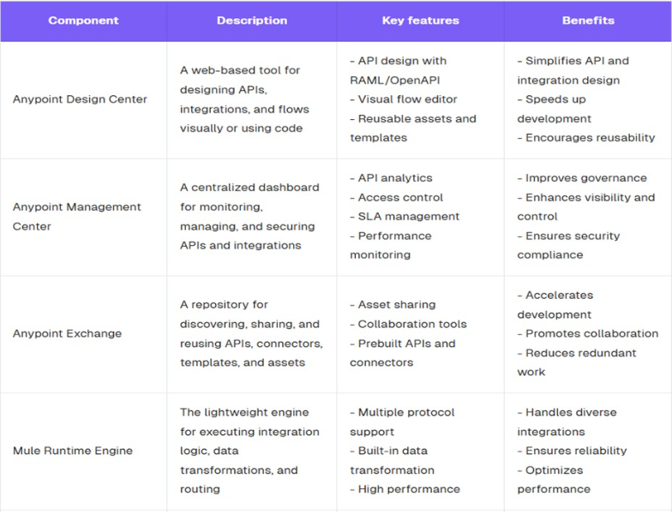

Slide 48
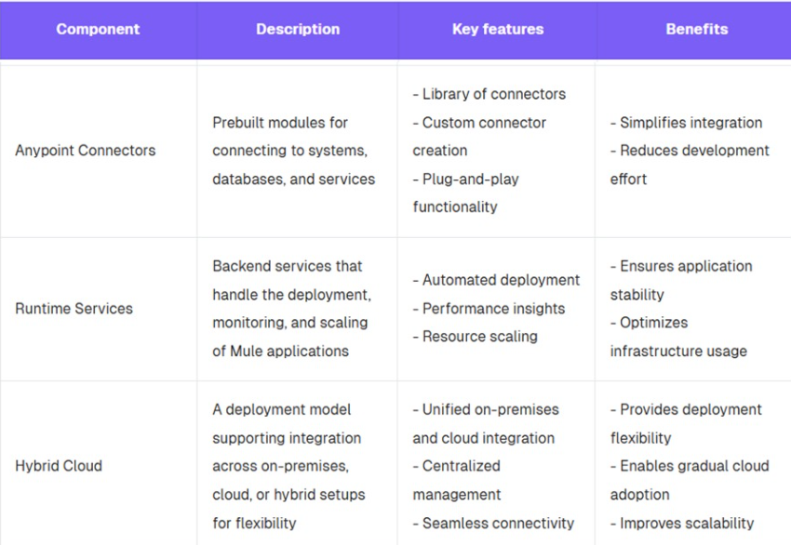

Slide 49
Anypoint Platform Benefits
Unlock legacy systems, rapidly connect legacy assets to SaaS technologies, and reduce integration costs—without disrupting existing business processes
Increase developer productivity and shrink development times through open technologies that promote reusability, modularity and collaboration
Reduce time to resolution by managing all resources from a single pane of glass
Increase innovation and value creation across the enterprise through tools that enable faster development, testing, and implementation of APIs
Increase agility with a flexible architecture that evolves as your business does
Create happier customers and competitive advantages by delivering services and experiences

Slide 50
1.Define API Led connectivity in detail with example
2.Differences between API and Web services
3. What is Anypoint Platform? What are the features available in Anypoint platform

Slide 51
Thank You

Slide 52
API-Led Connectivity

